Slide 1
Malware Detection using ML and Python
SUBMITTED BY :
RAMYA MIHIR(500067119)
ISHA MITTAL(500068884)
Under Guidance of our Mentor : J. Dhiviya Rose

Slide 2
TABLE OF CONTENTS
INTRODUCTION
Purpose Of The Project
Target
Project Scope
PROJECT DESCRIPTION
Reference Algorithm
Flowchart
SWOT Analysis
Design
Use Case Diagram
Activity Diagram
Sequence Diagram
Assumptions & Dependencies
SYSTEM REQUIREMENTS
NON FUNCTIONAL REQUIREMENTS
RESULTS
CONCLUSION
REFERENCES

Slide 3
INTRODUCTION

Slide 4
This project is related to Cyber Security Domain, where we will check whether the file is malicious or not.
Problems in today’s world:
Unaware of the cyber crimes
Lack of awareness of how to know if trapped
Providing permissions without knowledge
The project will be in Python language with the usage of Machine Learning Models.

Slide 5
PURPOSE OF THE PROJECT
The purpose of the project is:
To reduce the cyber crime rates to a smaller extend
To make people aware of the cyber attacks
Modern malwares use sophisticated techniques such as polymorphism and metamorphism to thwart the malware detection and analysis. Detecting malware on the basis of their features and behavior is critical for the computer security community, so identifying the malwares in the files is the main purpose.

Slide 6



TARGET
The target people who will be benefitted from this project are:
Working Professionals
People active on internet
Students

Slide 7
PROJECT SCOPE
The project scope is to create an easy platform for malware detection in real-time environment where the students, working professionals, and even the new internet generation people can scan and check for malwares in any file, in order to prevent themselves from getting trapped in cyber world.
Our main objective is to Identify and classify malwares using static analysis i.e. without executing with the help of Machine learning models.
So, we are basically providing a software which will run and ask for the file to be checked for malwares and notify the user for either to open it or not.

Slide 8
PROJECT DESCRIPTION

Slide 9

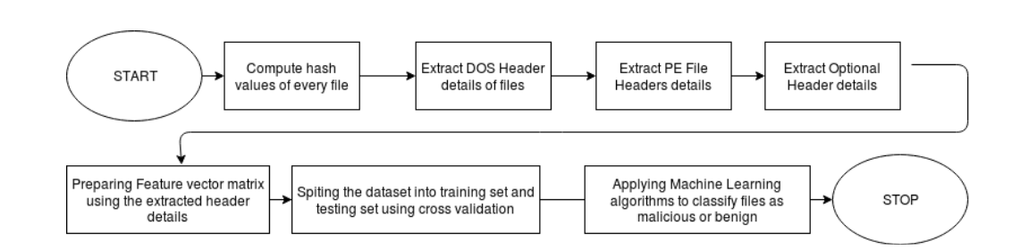
REFERENCE ALGORITHM
START
Compute hash values of every file and check whether any of the file in the corpus is duplicate and then remove the duplicate files.
Extract header details of the binaries with the help of PE File module functions of python for the analysis purpose.
The following header details are extracted
DOS header
PE File header
Optional header
Prepare the feature vector matrix by selecting best features for training and testing purpose of the dataset.
With Cross-Validation split the dataset into training and testing set.
Apply ML algorithms to classify files as malwares and benign Algorithms used to evaluate:
K-Nearest Neighbors
SVM (Support Vector Machines)
STOP

Slide 10
DESIGN
After the hash value for every file is computed.
Header details are extracted.
Applying the machine learning algorithms.
We have classified Unseen Setup files as legitimate or malicious

Slide 11
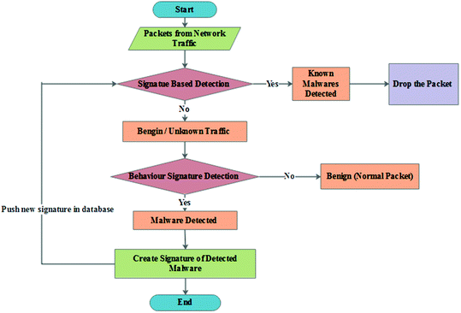
Flow chart

Slide 12
SWOT Analysis
STRENGTHS: The Support Vector machine and K-Nearest neighbor that are used to in the program, train the system which helps in providing higher accuracy when compared to other machine learning and deep learning models.
WEAKNESS: The model is quite heavy and requires a lot of processing power for testing stage. The available dataset for network trafﬁc are not very large, which affects the accuracy. In the project, we have not implemented the procedures for ﬁrewall protection, load description and handling, DDoS attacks etc. The rules for forwarding and dropping packets are also described, but are subject to human error.
OPPORTUNITIES: The work can be done in anomaly-based Network Intrusion Detection Systems (NIDS), ﬁrewall protection, load description and handling, and their respective Northbound and Southbound APIs. More research into this domain can help improve accuracy and handle various types of attacks.
THREATS: This project can only work with network packets. Adversarial malware attacks can bypass the discriminator classiﬁcation schema. Zero-day DDoS attacks can mostly cause network failure, as human errors could be present in ﬂow table handling.

Slide 13
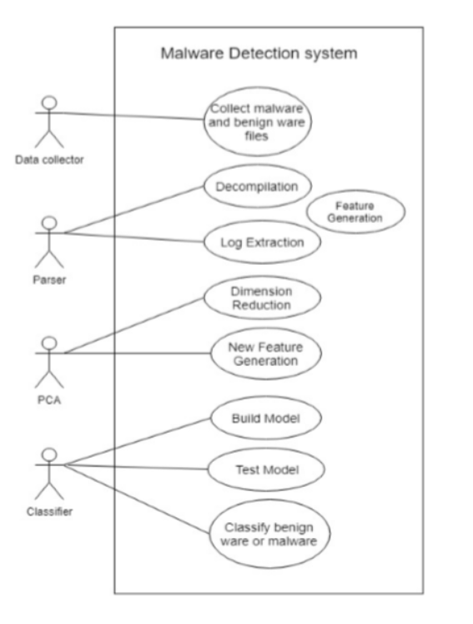
Use case diagram

Slide 14
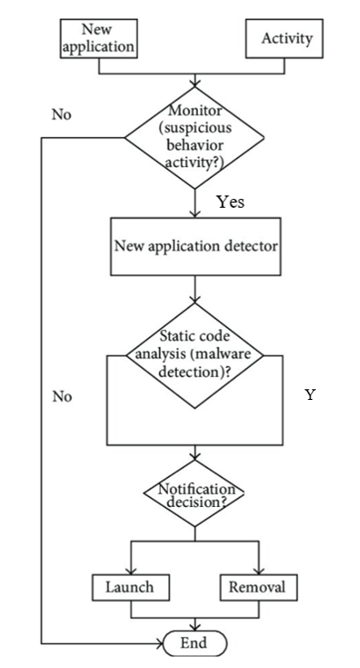
ACTIVITY diagram

Slide 15
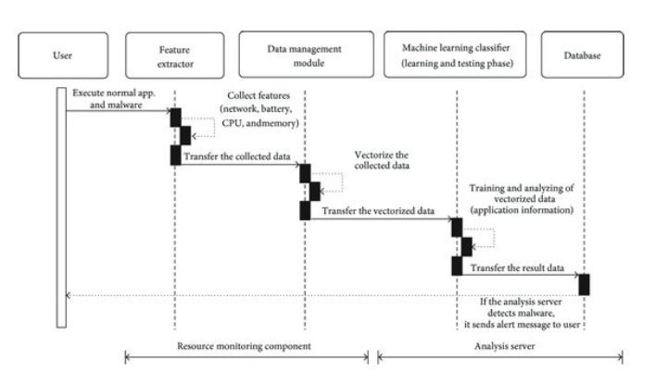
SEQUENCE diagram

Slide 16
ASSUMPTIONS & DEPENDENCIES
The user should know how to select a file before opening it.
The user should understand the output of whether the file is malicious or not; if malicious, what is that file name.
The project is dependent on the internet connectivity of the user. The project requires internet connection for multiple users.

Slide 17
SYSTEM REQUIREMENTS

Slide 18
SYSTEM DESCRIPTION
Through this platform, we provide the organizations and companies an option of mitigating any future malware attacks planned by the attackers to stay protected.
This project is done on a google collaborator, where the file received by the corporates can be checked for any vulnerability and thus, prevent it by either not opening it, or by bypassing that vulnerability.
The company can know whether it is completely legitimate or partially legitimate or is not at all safe to access that file, thereby aiding security, and integrity to the user.

Slide 19
USER INTERFACE:
Simple and easy to use system
Malware Detection using the APK dataset.
Machine learning is used to build the model
Comparative analysis is done
Classiﬁcation report is generated.
SOFTWARE INTERFACE:
Programming Language: Python
Operating System: Windows
Dataset: APK dataset
DATABASE INTERFACE:
Google Collaborator

Slide 20
NON FUNCTIONAL REQUIREMENTS

Slide 21
PERFORMANCE REQUIREMENTS
The system should be based on web and has to run form a web server
The system should take initial load time depending on internet connection strength of user which also depends on the media size uploaded on the application.
SECURITY REQUIREMENTS
The system must check for authorization.
The system should check for malware file.
The system must automatically warn the user if found malicious.
SOFTWARE QUALITY ASSURANCE
AVAILABILITY: Malware Detection will be for each user every time.
CORRECTNESS: The detector should always connect to the correct malware apk file.
MAINTAINABILITY: Detector should maintain its state even if any older or newer files is checked.
USABILITY: Detector should satisfy a maximum number of users needs of having a malware free file.

Slide 22
LIMITATIONS
File must be accessed from google drive,
Currently, this program is only able to detect malicious content in the tabular form of data, hence no files other than CSV or XLSX are possible to detect.
It requires authentication every time it compiles and runs, although it is an additional security feature but might be a limitation for access at different devices.
The program is only executable on google collab due to dependency on google drive.

Slide 23
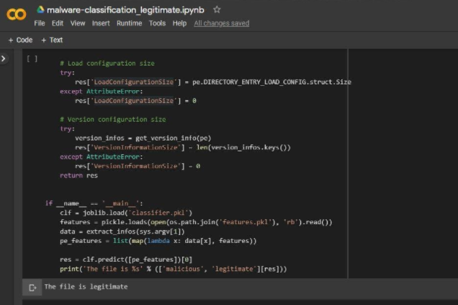
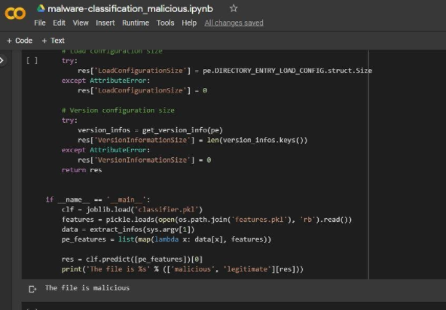
results
Legitimate and safe
Malicious and unsafe

Slide 24
Conclusion
To identify mobile malware and malicious activity, researchers employed static, dynamic, and hybrid approaches. The key interest of researchers is accuracy levels, and the majority of research articles use accuracy measures to explain the efficacy of their detection technique.
As a result, with this study, we present a novel method for detecting malware that relies on static analysis rather than execution. We will identify malwares if they are present in any file using various machine learning models in order to avoid additional assaults.

Slide 25
REFERENCES
[1] Machine Learning Models and applications (https://media.kaspersky.com/en/enterprise-security/Kaspersky-Lab-Whitepaper-Machine-Learning.pdf)
[2] ML models required for Malware Analysis (https://www.ccsinet.com/blog/machine-learning-malware-analysis/)
[3] Working method for Malware Analysis (https://sectigostore.com/blog/malware-analysis-what-it-is-how-it-works/)
[4] Malware Detection and Removal Types and Introduction (https://www.imperva.com/learn/application-security/malware-detection-and-removal/)
[5] Images (https://link.springer.com/chapter/10.1007/978-3-319-63673-3_21) (https://ai.plainenglish.io/malware-detection-using-hybrid-analysis-4b0ef471e844) (https://www.researchgate.net/publication/289674086_Detecting_Malware_for_Android_Platform_An_SVM-_based_Approach/figures?lo=1&utm_source=google&utm_medium=organic) (https://www.semanticscholar.org/paper/Malware-detection-using-assembly-code-and-control-Anju-Harmya/96b22134053f4a0cce2a8f9961131a42af831b8f)

Slide 26
THANK YOU

